Slide 1
Evaluating transcript assembly
We want to compare the assembly output against a benchmark transcriptome where correct sequences of all transcripts are known.
Limitations of using a known reference transcriptome:
variability in the transcriptome (e.g. among e.g. cell types) makes it impossible to determine whether sequences from the reference that are missing from the assembled transcriptome are due to assembly errors, or whether they were not expressed in the library sequenced
transcriptome sequences may also vary between the individual under study and the reference

Slide 2
Common reference annotation databases

Slide 3
Benchmark transcriptome
We don’t have RNA-seq data from a transcriptome where all transcript sequences and expression patterns are known => simulate the sequencing of a given benchmark transcriptome to comprehensively assess all of the assembly errors.
Tools that can generate simulated reads modeling the errors and biases introduced by
short Illumina reads: RSEM, FluxSimulator, Polyester
long third- generation sequencing reads: PBSIM, Trans-NanoSim
Using simulated RNA-seq data allows the quantification of each of the following categories:
  correctly assembled sequences (true positives or TPs)
  sequences that are assembled with errors (false positives or FPs)
  sequences in the reference that are missing from the assembly (false negatives or FNs)

Slide 4
Transcriptome assembly metrics
P – positive
N – negative
☺ TP – True Positive, we found correct transcript
☺ TN – True Negative, we did not find transcript where there was none
☹ FP – False Positive, we found transcript where there was none
☹ FN – False Negative, we missed transcript
P = TP + FN
N = TN + FP

Slide 5
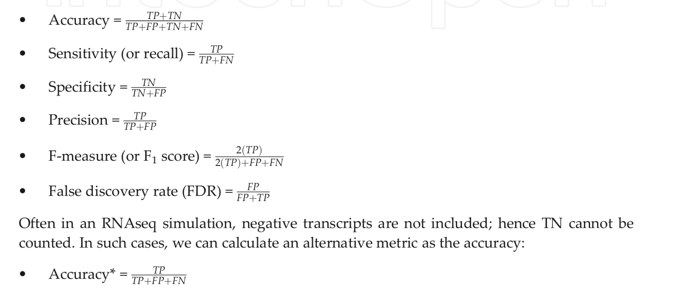
Assembly metrics based on benchmark
P = TP + FN
N = TN + FP

Slide 6
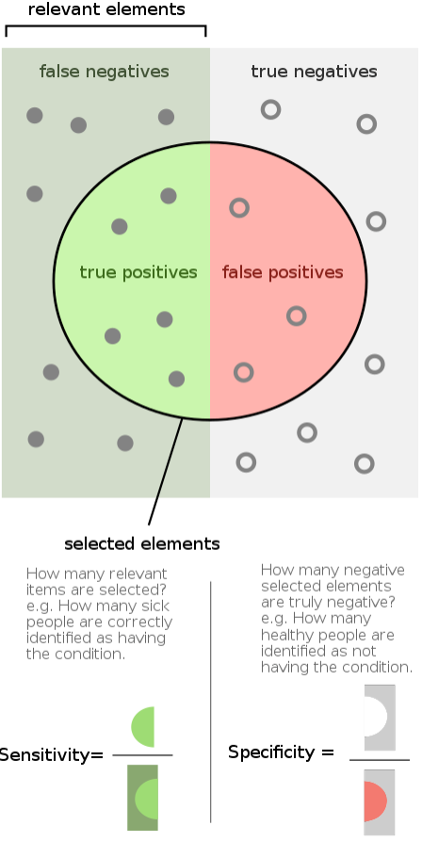
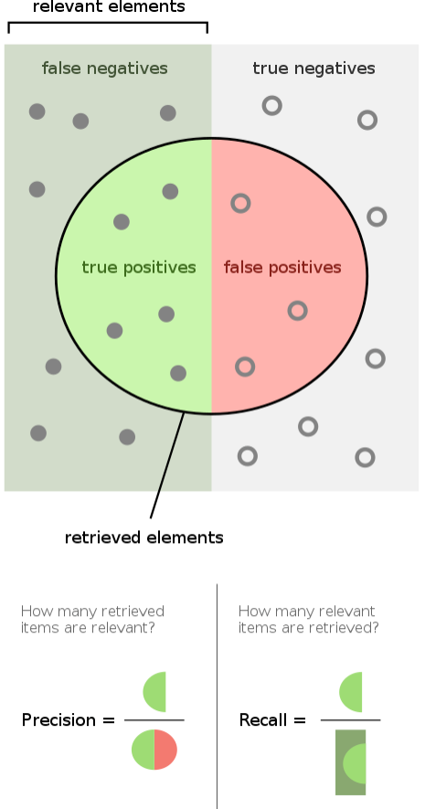
Measures of correctness
Sensitivity (Recall), Specificity
and Precision
Image credit: Wikipedia

Slide 7
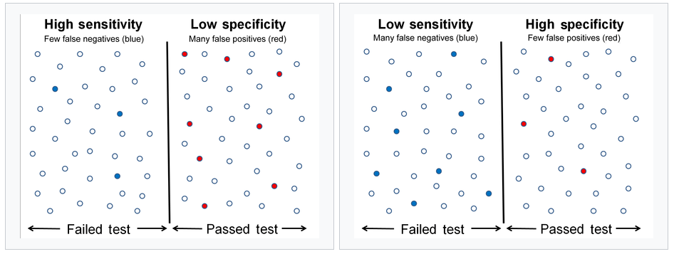
Sensitivity and Specificity

Slide 8
Nucleotide level accuracy
TN
FN
TP
FP
TN
FN
TP
FN
TN
REALITY
ASSEMBLY
Sensitivity:
Precision:

Slide 9
Exon level accuracy
WRONG
EXON
CORRECT
EXON
MISSING
EXON
REALITY
ASSEMBLY
Exon Sensitivity
Exon Precision

Slide 10
Transcript level accuracy
< 80%
REALITY
ASSEMBLY
WRONG!
Same exon-intron structure => CORRECT!
CORRECT!

Slide 11

gffread, gffcompare and trmap
gffread, gffcompare and trmap
- a fast tool for verification, filtering and conversion of the most popular annotation file formats (GTF, GFF3, BED) and for quick extraction of transcript sequences from the genome sequence.
FASTA:
GFF/BED:
gffread -w
http://ccb.jhu.edu/software/stringtie/gff.shtml

